Slide 1




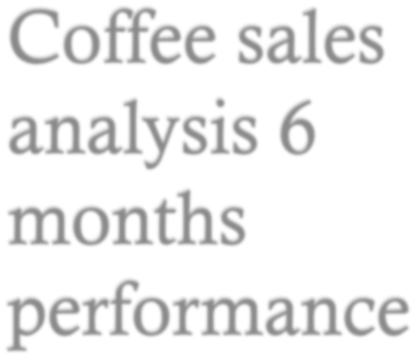
















1

Slide 2







Analyse overall sales performance
Identify key revenue drivers
Understand customer purchasing behaviour
Provide data-driven recommendations

Slide 3




Data processed using SQL in Databricks
Revenue calculated as: Quantity × Price
Data exported to Excel for analysis
Pivot tables and charts used for visualisation

Slide 4











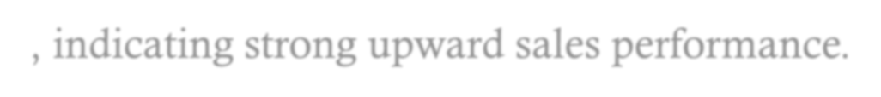

Monthly Revenue Trend by Store
R60 000,00
R50 000,00
R40 000,00
Astoria
Hell's Kitchen Lower Manhattan
R30 000,00
R20 000,00
R10 000,00
R 0,00
Jan
Feb
Mar
Apr
May
Jun
Revenue increased steadily from approximately R26,000 in January to over R55,000 in June across all stores.
This reflects an overall growth of more than 100%, indicating strong upward sales performance.

Slide 5



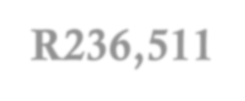
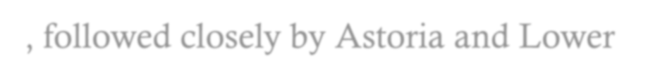




R238 000,00
Total Revenue by Store
R236 000,00
R234 000,00
R232 000,00
Total
R230 000,00
R228 000,00
R226 000,00
Astoria
Hell's Kitchen
Lower Manhattan
Hell’s Kitchen recorded the highest total revenue at approximately R236,511, followed closely by Astoria and Lower Manhattan.
The difference between stores is relatively small, indicating
balanced performance across locations.

Slide 6


Lower Manhattan
33%
Revenue Contribution by Store
Astoria
33%
Astoria
Hell's Kitchen
Lower Manhattan
Hell's Kitchen
34%
Insights: Each store contributes roughly 33% of total revenue, with no store dominating significantly.
This balanced distribution suggests stable multi-store
performance and risk diversification.
6

Slide 7











Revenue by Time of Day
R450 000,00
R400 000,00
R350 000,00
R300 000,00
R250 000,00
R200 000,00
Total
R150 000,00
R100 000,00
R50 000,00
R 0,00
01. Morning
02. Afternoon
03. Evening
Insights: The morning period generates the highest revenue compared to afternoon and evening sales.
This indicates peak customer activity during early hours, likely
driven by breakfast demand.

Slide 8



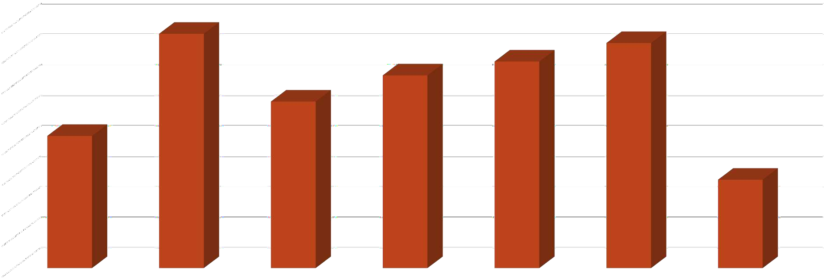







Revenue by Day of Week
R102 000,00
R101 000,00
R100 000,00
R99 000,00
R98 000,00
Total
R97 000,00
R96 000,00
R95 000,00
R94 000,00
Sun
Mon
Tue
Wed
Thu
Fri
Sat
Insights: Revenue differs between weekdays and weekends, reflecting changes in customer behaviour.
This highlights the impact of work schedules and leisure time on purchasing patterns.

Slide 9








Revenue by Product Category
Packaged Chocolate
Flavours Loose Tea Branded
Coffee beans
Total
Drinking Chocolate
Bakery
Tea Coffee
R0
R50 000
R100 000
R150 000
R200 000
R250 000
R300 000
Insights: Coffee and Tea categories generate the highest revenue compared to other product categories.
This indicates that core beverage products are the main drivers of sales performance.
20XX
9

Slide 10








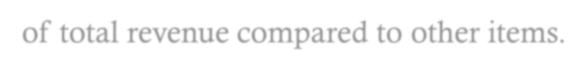





Top Selling Products
R25 000
R20 000
R15 000
R10 000
Total
R5 000
R 0
Sustainably Dark chocolate Lg Grown Organic
Lg
Latte Rg
Cappuccino Lg Morning Sunrise
Chai Lg
Latte
Jamaican Coffee River Lg
Sustainably Grown Organic Rg
Cappuccino
Brazilian Lg
Insights: The top-performing products contribute a large share of total revenue compared to other items.
This shows that customer demand is concentrated among a few key products.
20XX
10

Slide 11








R1 600,00
R1 400,00
R1 200,00
R1 000,00
R 800,00
Total
R 600,00
R 400,00
R 200,00
R 0,00
Dark chocolate
Earl Grey
Spicy Eye Opener Chai
Guatemalan Sustainably Grown
Lemon Grass
Insights: The lowest-performing products contribute minimal revenue relative to top items.
This suggests low demand and potential inefficiencies in product
offerings.
20XX
11

Slide 12






Packaged Chocolate
Branded Loose Tea Coffee beans
Flavours
Total
Drinking Chocolate
Bakery
Tea Coffee
0
10 000
20 000
30 000
40 000
50 000
60 000
70 000
80 000
90 000
100 000
Insights: Coffee and Tea categories record the highest number of units sold compared to other categories.
This indicates that these products drive both volume and revenue,
reinforcing their importance to the business.
20XX
12

Slide 13











Weekday vs Weekend
R600 000,00
R500 000,00
R400 000,00
R300 000,00
Total
R200 000,00
R100 000,00
R 0,00
Weekday
Weekend
Insights: Revenue differs between weekdays and weekends,
reflecting changes in customer behaviour.
This highlights the impact of work schedules and leisure time on purchasing patterns.

Slide 14



Revenue shows consistent growth
Morning is the peak sales period
Sales patterns vary by day and time
A few products dominate revenue

Slide 15


Increase stock of high-performing products
Promote underperforming items
Target marketing during slow periods
Optimise staffing during peak hours

